Slide 1
Now to Make Your Own AR!
--Click on “Plugins” then “Augment Uploader”

Slide 2
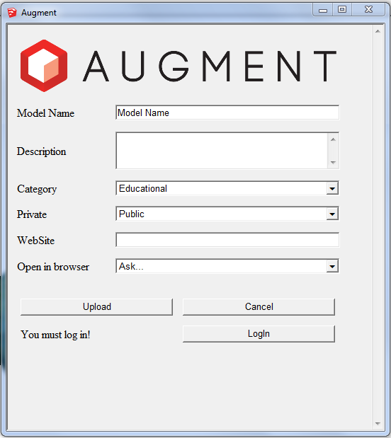
Now to Make Your Own AR!
--Click “LogIn” and enter your login info that you entered earlier on the Augment website.

Slide 3
Now to Make Your Own AR!
--Type in a name.
--Add a description (if you wish)
--You can leave the category as
“educational”
--Choose “Public” for privacy
Don’t worry about the rest of the settings. Click Upload!

Slide 4
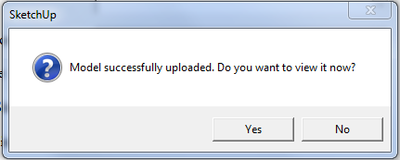
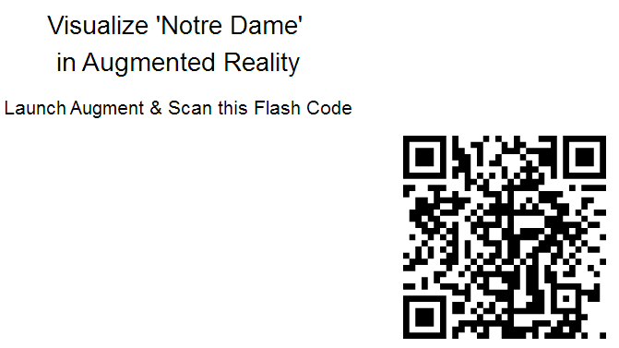
Now to Make Your Own AR!
--Augment Uploader will work its magic and then ask if you wish to view it…after all this setup, you probably should click “Yes.” ☺
--Open the “Augment” app on your phone / tablet and tap “Scan” while pointing the camera at the QR code. It will take a moment to download the model.

Slide 5
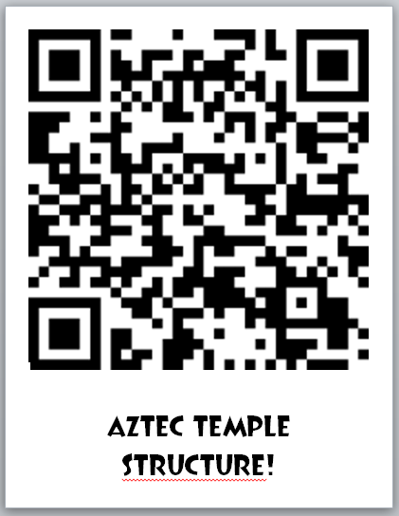
How to Present to Students!
--Copy the QR code and paste it into a presentation (students aim @ screen)
--Copy and paste the QR code into MS Word and create a poster (walking tour?)

Slide 6
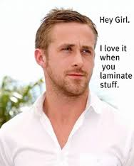
FYI / Word of Caution…
--QR codes are temporary…no laminating the posters to last forever. ☹
--You CAN “rinse and repeat” the process to quickly insert a new QR code into the MS Word poster.

Slide 7
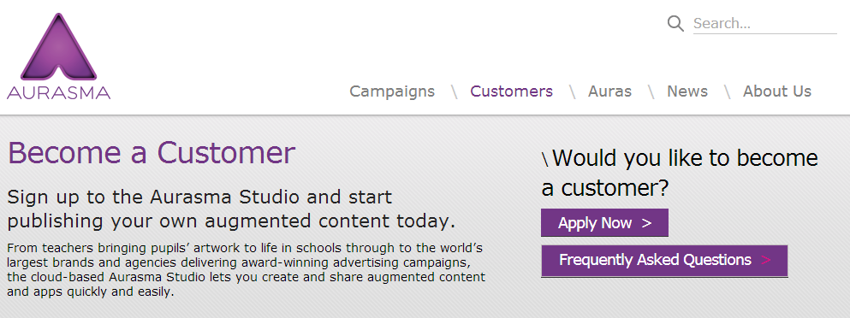
The Holy Grail of AR…
--Please go to www.aurasma.com on your smart device.
--Click on the tab “Customers” @ the top of the page and “Apply Now.”

Slide 8
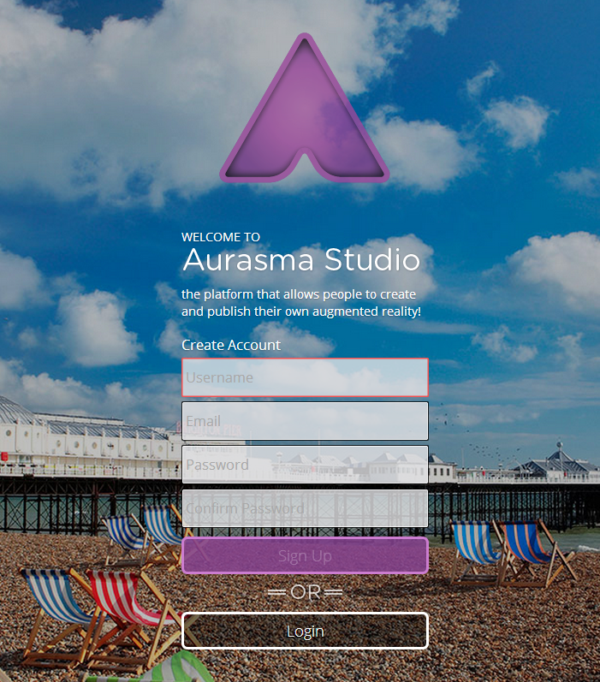
--Please take a moment to fill in the relevant info to create an account.

Slide 9
A Quick Intro…
--Please open your Aurasma app and have it at the ready!

Slide 10
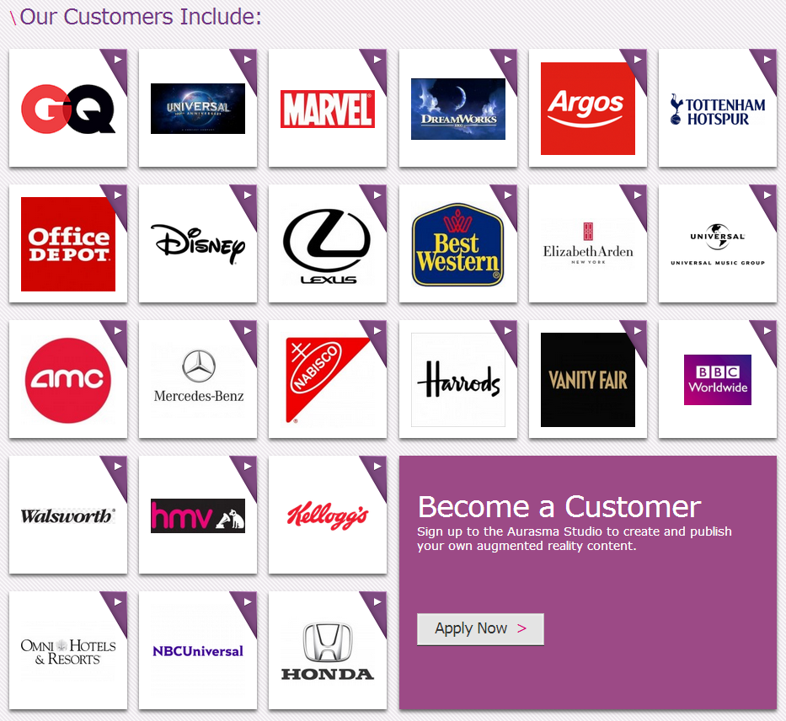

Slide 11
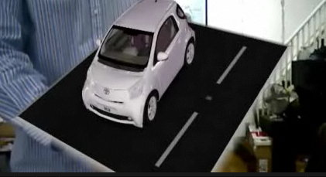
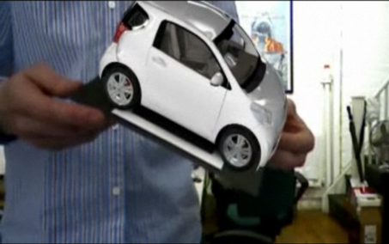
You Think THAT’S Interactive?!
--What does the future hold for Augmented Reality?

Slide 13
Final Thoughts…
It is really up to us to make our own “connected classroom” a reality.
The truly inspired uses of technology like we have seen all day at this conference are the result of educators thinking outside the box.
Ultimately, educators will only incorporate new techniques and technology that they find useful. My purpose today was to help empower not only you, but your students to take this technology to new levels.

Slide 14
Contact Info:
Email → teechur@hotmail.com
ahaak@holton.k12.mi.us (yes, the long format still) 😐
Website → http://teechur.weebly.com (no “www”)
Twitter → @andrew_haak

